Slide 1


www.CSLWorld.com

Slide 2
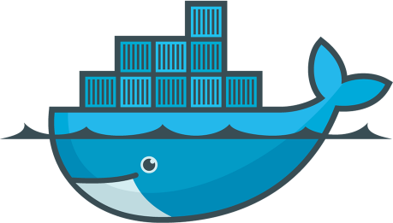
Introduction To Docker
Kanishka Dilshan De Silva

Slide 3
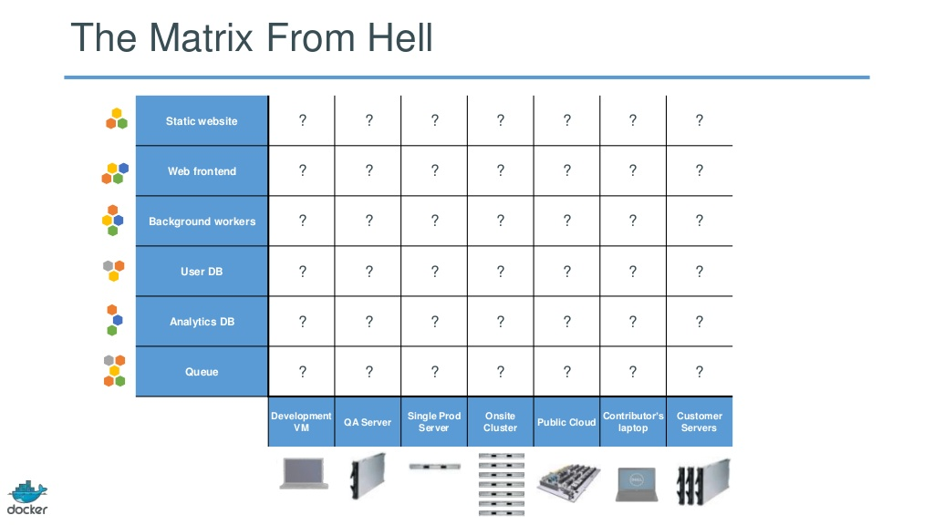
The Challenge

Slide 4
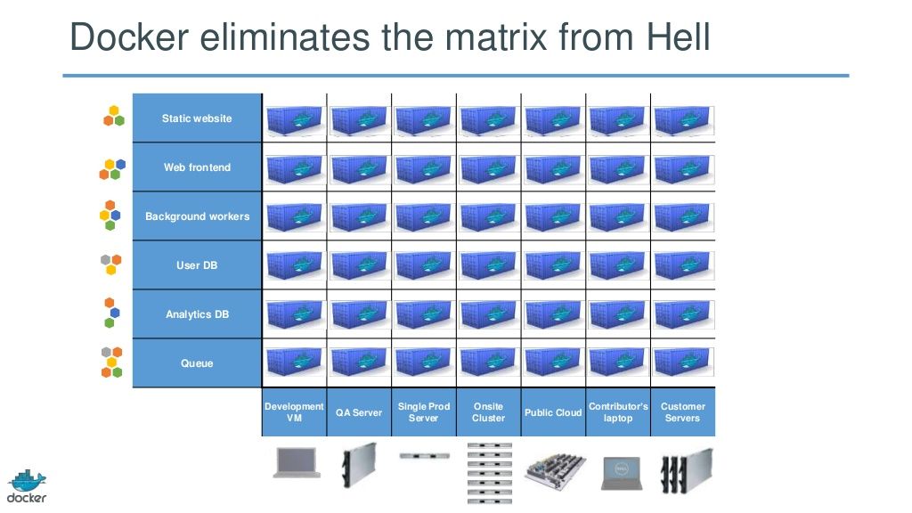
The Solution

Slide 5



Why Docker?
Build
Ship
Run

Slide 6
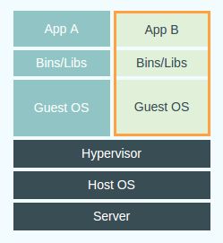
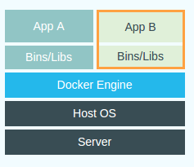
Docker vs Virtual Machines
VM
Docker

Slide 7
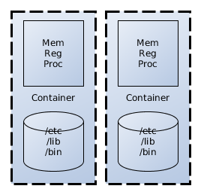
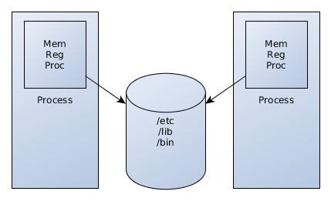
Process vs Container
Linux kernel features
Kernal namespaces
Control groups (cgroups)

Slide 8
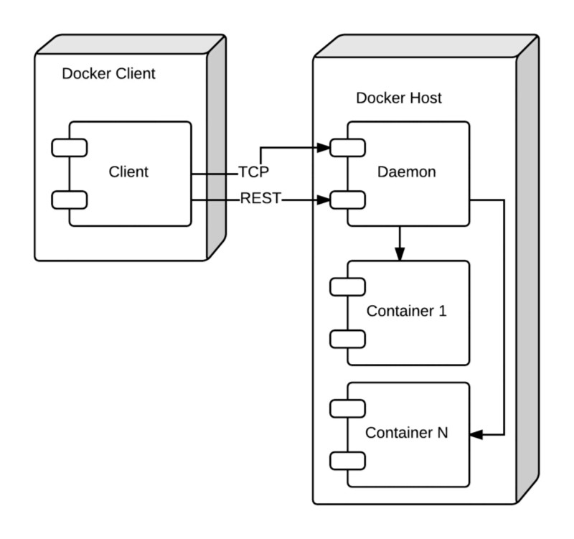
The Docker Architecture

Slide 9
Setting up Docker
https://docs.docker.com/installation/
Ubuntu 14.04
$ sudo apt-get update
$ sudo apt-get install docker.io
Windows
Using Boot2Docker*
Mac Osx
Using Boot2Docker*
*Boot2Docker (~24Mb lightweight linux distribution)

Slide 10
Docker CLI Commands
search
run
ps
start
stop
restart
rm
rmi
kill
commit
pull

Slide 11
Docker CLI Examples
Creating a simple container from an image
docker run -i -t ubuntu:14.04 /bin/bash
Listing containers
docker ps
Stop container
docker stop <container hash>
Remove container
docker rm <container hash>

Slide 12
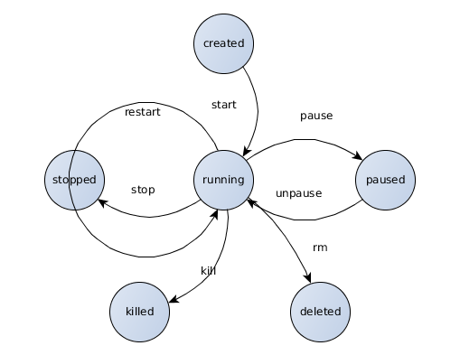
Container Lifecycle

Slide 13
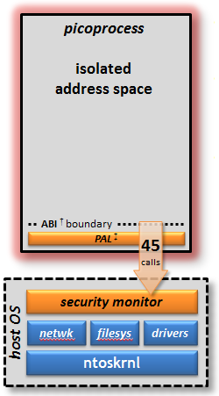
MS Native Alternatives
Drawbridge - Still in research level
picoprocess = container

Slide 14






Use Cases
Easy application deployment
Continuous Integration
Continuous Delivery

Slide 15
Q&A

Slide 16
Demo

